Slide 1
Practical GUI Testing of Android Applications via Model Abstraction and Refinement
Tianxiao Gu, Chengnian Sun, Xiaoxing Ma, Chun Cao, Chang Xu
Yuan Yao, Qirun Zhang, Jian Lu, Zhendong Su
Notes:
Good afternoon everybody. My name is xxx. I’m from NJU. And I’m gonna introduce the work of the paper Pratical….

Slide 2
Outline
Model-based App GUI Testing
Our Approach: GUI Model Abstraction and Refinement
Experiments and Results
Notes:
First I’ll try to review the technique of model base app testing and some current research work
Then I’ll introduce our approach, that is model abstraction and refinement for GUI testing
And at last I’ll show the experiments and result of our work

Slide 3
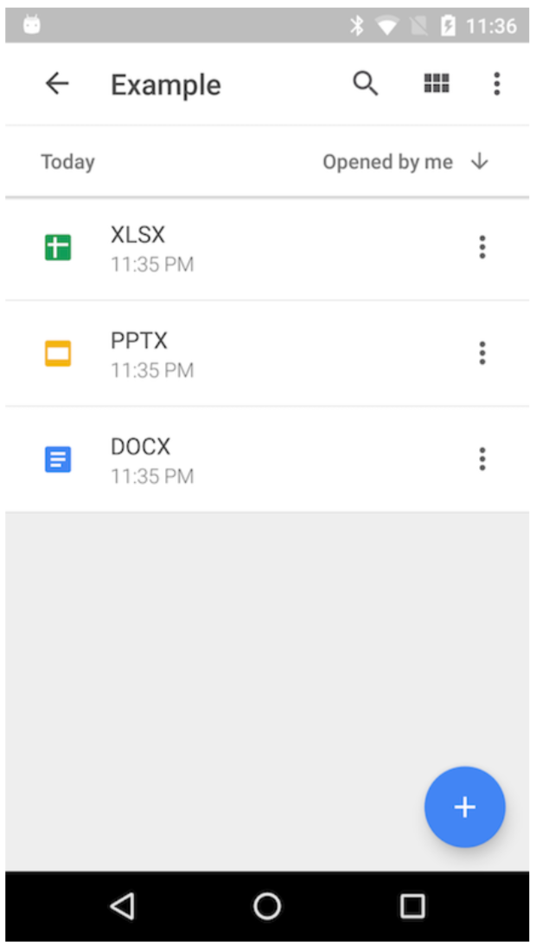
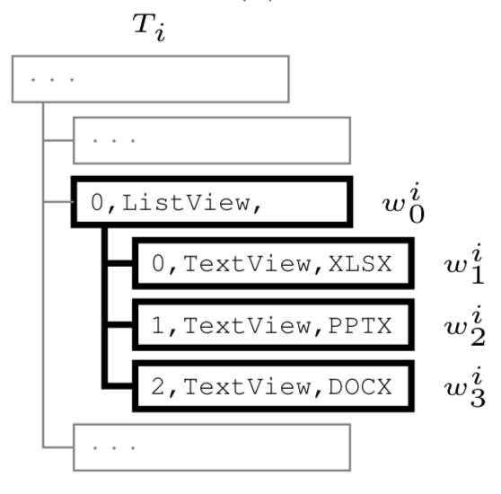
Automated GUI Testing for Android Apps
App testing: fuzzing/symbolic execution/evolutionary algorithm
Model-based Testing: Stoat/AMOLA/AimDroid…
Abstraction
Si
GUI
GUI Tree/State
Model State
Notes:
App testing is importation to developers. Usually they use google fuzzing tool, that is the monkey testing tool. As monkey works blindly by generates random UI events on the GUI, most people think it inefficient. So testing techniques such as symbolic execution are also applied against android apps. Or even evolutionary algorithm was proposed to generated test cases for app testing.
As the GUI on the screen is actually rendered from a GUI tree and the android system provide tools/services for you to get the data of this tree. Therefore, we can send the widget action (click/swipe/etc) directly to simulate user interaction and do UI testing. But to trigger every widget action leads to state explosion，so we have to build an abstraction model for more efficient UI event generation. Current work includes STOAT/AMOLA/AimDroid etc
Model-based testing is also intensively studied for more efficient GUI testing.
For model-based testing, it tries to recognize what’s on the current UI, and guide the testing tool to generate event
Abstract GUI actions to model actions and GUI trees to model state
图的例子：说明GUI Tree 到 Model Actions Set(Model State)
缺陷：Static Abstraction based on certain heuristics

Slide 4
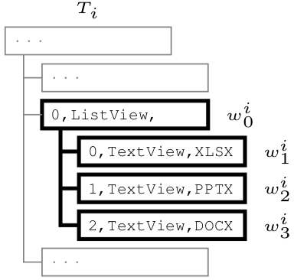
GUI Modeling
Existing work builds static abstraction based on certain heuristics
Abstraction
GUI widget denoted in is full attribute path
Reduces the full attribute path
to denote a widget in model

Slide 5
An Illustrative Example
GUI State
GUI
Model State
X
?
P
W
We need a model that sees there are three different widgets in the list.
Notes:
this is the google drive app. In its list, There are three files, a word, powerpoint and excel file respectively. Clicking each of these item, the app transit to new states.
We hope we can abstract the GUI state into a model state, which can guide the test tool to click the three files for three different gui state, and nothing more.
So how can we do this？

Slide 6
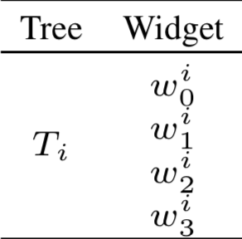
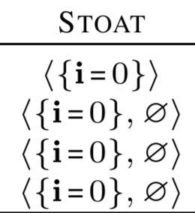
Stoat
Guided, Stochastic Model-based GUI Testing of Android Apps (FSE'2017)
We’ll see only one model widget in the list and it can lead to three different target states (non-deterministic transition)
Too coarse-grained
GUI State
Model State
GUI
Tree
Stoat abstracts the widget with its index (among its siblings) and cares nothing for items in a ListView
Notes:
In the model-based testing work ,Stoat [stoʊt], each widget is modeled with its index attribute
Apparently the three items in the listview abstracted into the same model widgets, which means the testing tool will see a same model

Slide 7
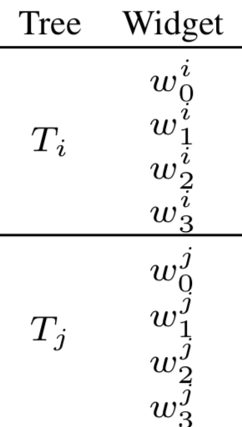
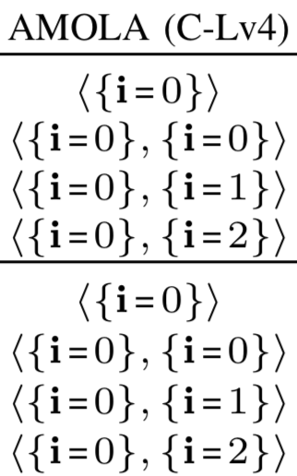
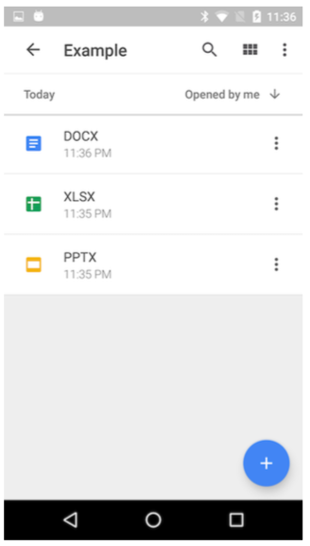
AMOLA(C-Lv4)
Automated Model-Based Android GUI Testing using Multi-Level GUI Comparison Criteria (ASE 2016)
AMOLA C-Lv4 abstracts the widget with its index (among its siblings) including items in a ListView
$w_{1}^{i}$ and $w_{1}^{j}$ are abstracted to same model widget but lead to different target states
Still too coarse-grained
Different GUI states map to a same model state
Notes:
The work AMOLA can select multiple abstraction levels for GUI model generation. With its Lv4 selection
If leaves this GUI state and later return to it, the items in the list can be reordered, because the app would have the latest open one on top.
In this case, the different GUI state will have a same model state, and the same model widget can lean to different states

Slide 8
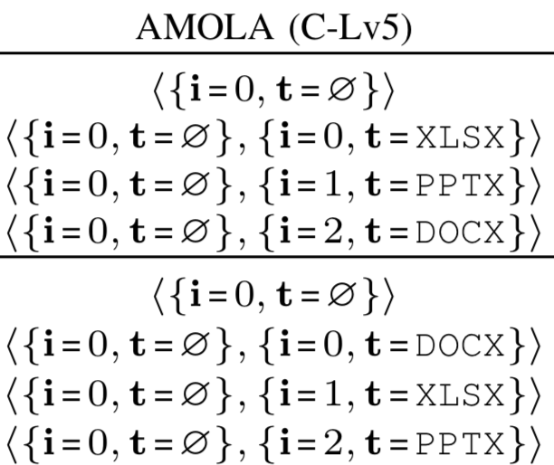
AMOLA(C-Lv5)
AMOLA C-Lv5 Considering widget text attribute additionally
and treats $w_{1}^{i}$ and $w_{3}^{j}$ differently
Too fine-grained abstraction (T_{i} T_{j} are different model states) to generate too many model states
Permutation
Notes:
AMOLA can generate finer model by considering widget’s text attribute as well
You can see widget in different place is not the same now although they are actually the same one

Slide 9
Problem of the static abstractions based on heuristics
Too Fine-grained
State explosion
Unnecessary UI events
Too Coarse-grained
Inaccurate test knowledge
Non-deterministic transition
What’s the appropriate granularity for an App’s GUI modeling?
Notes:
细粒度的例子：1.直接只用Full Attribute Path;2. index+text+parent
粒度粗的两个例子
Stoat: 在同一个GUI树中，三个GUI Action被Abstract成同一个Model Action
AMOLA: 考虑index，在两个GUI树中同一个Model Action也会状态不一致
Fine-grained: state explosion
Coarse-grained: fail to gather accurate knowledge on model actions to realize guidance/non-deterministic

Slide 10
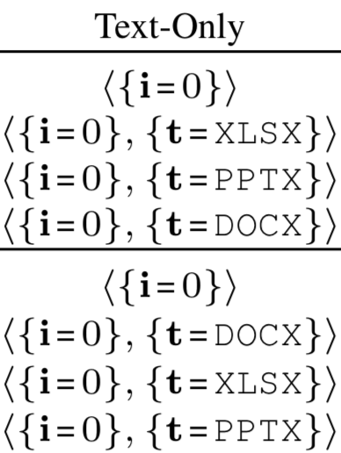
For this illustrative example
Take the text attribute instead of the index for ListView items
Appropriate abstraction for the GUI tree
But how can a testing tool know this?
Notes:
这一页说明Abstract的过程

Slide 11
Our Approach
State abstraction function as a decision tree
Full Attribute Path
Reducer
Reducer
Reducer: function to map widget attribute path into a model widget(action)
This is a function for STOAT
Model Widget(Action)
Reduced Attribute Path
Selector
Selector: attribute path matcher
This function products model states that are too coarse-grained and lead to non-deterministic transitions
Then what?

Slide 12
State Abstraction Refinement
Start from a default abstraction(e.g.Stoat) and refine the abstraction during test
Refinement $ℒ1$ : add a branch <{i=0}, ∅> and a leaf node
only temporally eliminate the non-deterministic transitions
Refinement still fails when considering the different GUIs abstracted to the same state
This is a function for AMOLA (C-Lv4)

Slide 13
Refine again to $ℒ2$
State Coarsening: revert to the previous $ℒ1$
This is a function for AMOLA (C-Lv5)
Refinement $ℒ2$ : add a branch <{i=0}, ∅> and a leaf node considering both the index and text attribute
Eliminate the non-deterministic transitions
But different model widget (action) leads to same target transition
State explosion
Notes:
为什么是新增一个节点RI X Rp，而不是修改或者替换Rp节点

Slide 14
Refine again to$ℒ3$
Refinement $ℒ3$ : replace the leaf node with a new one which considers only text attribute

Slide 15
Our modeling approach
State size – “Increase and decrease size when necessary”
Refinement
Coarsening
No model action abstracts more than α GUI actions in a GUI tree
No model state is refined into β new states
Instead of a static abstraction based on certain heuristics throughout the testing of an app, we propose a dynamic approach by searching for the appropriate abstraction for each app respectively.
Non-deterministic transitions should be “as few as possible”
Notes:
Refinement will replace the current abstraction function by a new one and coarsening will check whether the new abstraction function refines a state into β new states. If such cases happen, refinement will be rejected.

Slide 16
Corresponding Algorithm
No model action abstracts more than α GUI actions in a GUI tree
No model state is refined into β new states
Non-deterministic transitions should be as few as possible

Slide 17
Implementation and Experiments
APE
https://github.com/tianxiaogu/ape
Ape vs Sapienz vs Stoat vs Monkey
Objects: 15 widely-used apps from the Google Play Store
Sapienz: Multi-objective Automated Testing for Android Applications, ISSTA'16
Notes:
[‘seɪpɪənz]

Slide 18
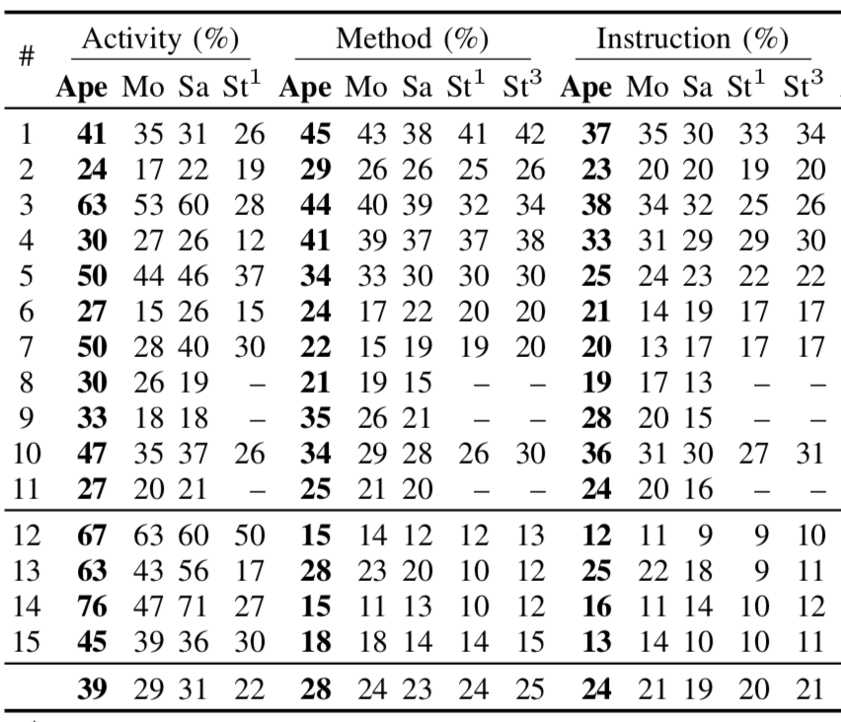
Result - Coverage
APE consistently resulted in
26– 78%, 17–22% and 14–26%
relatively improvements over
the other three tools
in terms of coverage
Notes:
这主要是大部分Android app都是做简单的UI操作，主要的计算都是在服务端，但是根据一些用户反馈，ape还是比较快速的提升coverage的。

Slide 19
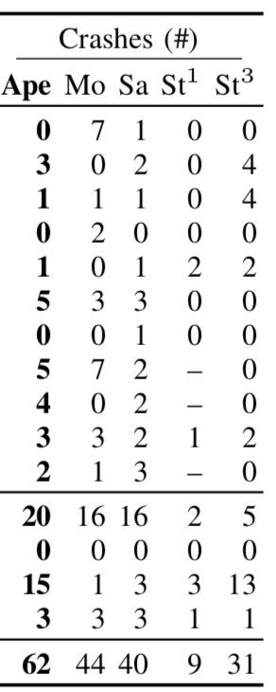
Result - Crashes
APE detected 61 crashes,
while Monkey detected 44,
SAPIENZ 40, and STOAT 31
Unique Crashes
Notes:
我们主要是通过unique normalized stack trace，也就是Java异常stack trace里的message被移除了，只考虑异常类型，方法，行号这些信息。

Slide 20
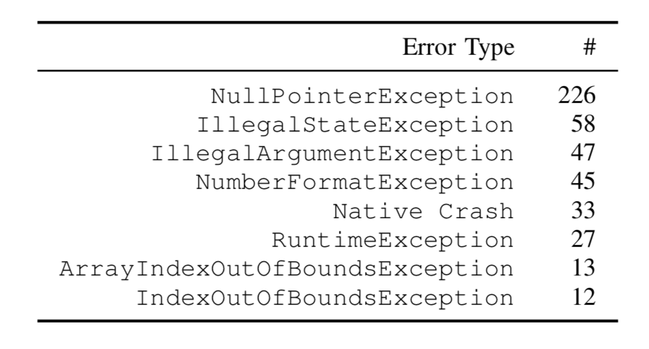
Large-Scale Evaluation
1,316 apps from the Google Play Store for 30 minutes each
537 unique crashes detected in 42 error types from 281 of 1,316 apps
38 crashes reported to developers with steps to reproduce the crashes, where 13 have already been fixed, and 5 have been accepted (fixes pending).

Slide 21
Thank you!
Any Question?
Email: tianxiao.gu@gmail.com

